Slide 1
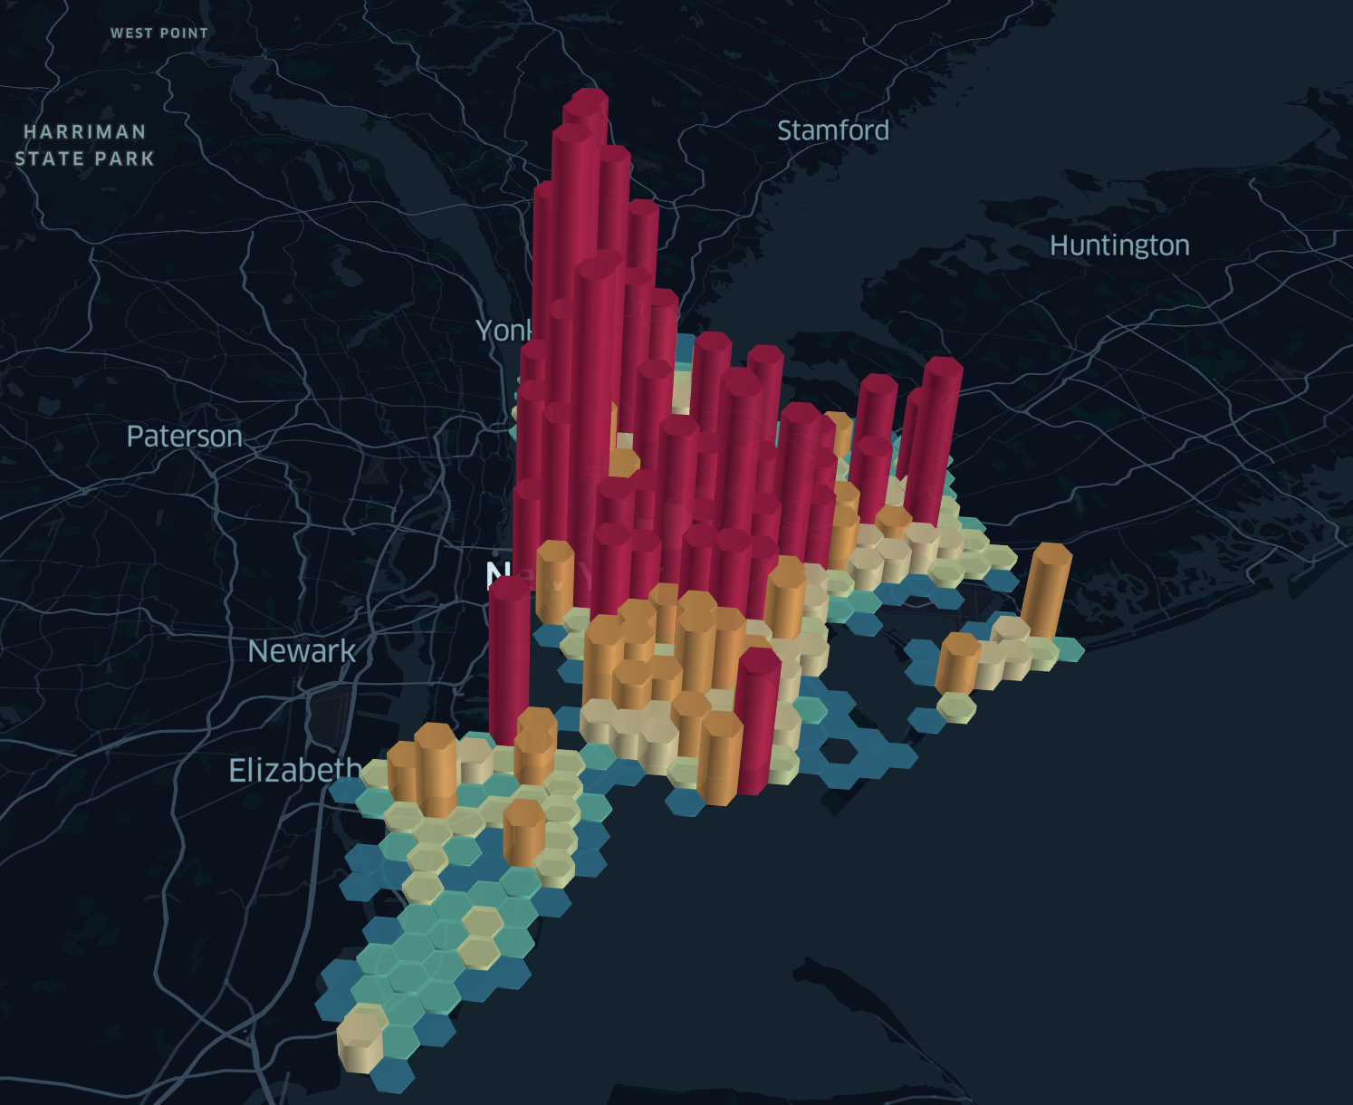
NYPD ARREST DATA
Group 6
Chutong Qiu
Huiyang Ni
Jiuli Wei
Yanru Zhou
Cheng Qian
Xiongxiang Fan
Notes:
Today we want to share our final project NYPD arrest data

Slide 2
OUR GOAL
Bronx
Analyze the distribution of crime in New York City by using 2021 NYPD arrest data so as to:
provide guide for citizens to live safely.
help NYPD to improve the safety of New York City.
For example, by assigning the appropriate number of police according to the crime rate in the precinct, and by taking actions to prevent the crime types that have a high rate of occurrence, etc.
Staten Island
Queens
Manhattan
Brooklyn
Notes:
As one of the world's centers for finance, culture, art and tourism, New York is visited and even settled by a large number of visitors, job seekers and students every year. And how to choose a safe area to settle in this strange city is a great concern for them. To address this problem, we provide charts and maps as a guide for new citizens to live safely based on the crime data of New York City in 2021.
In addition, our result can also help NYPD to improve the safety of New York City. For example, by assigning the appropriate number of police according to crime rate, and by taking actions to prevent the crime types that have a high rate of occurrence.

Slide 3
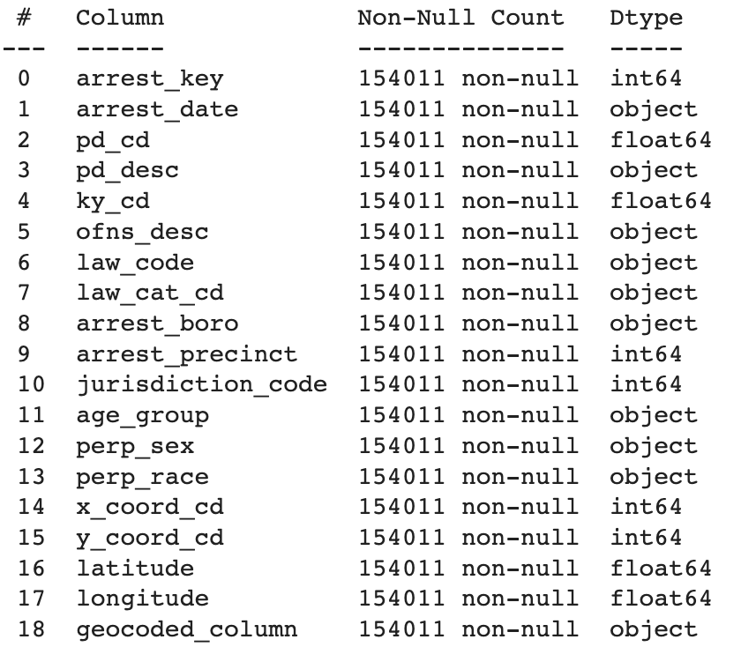
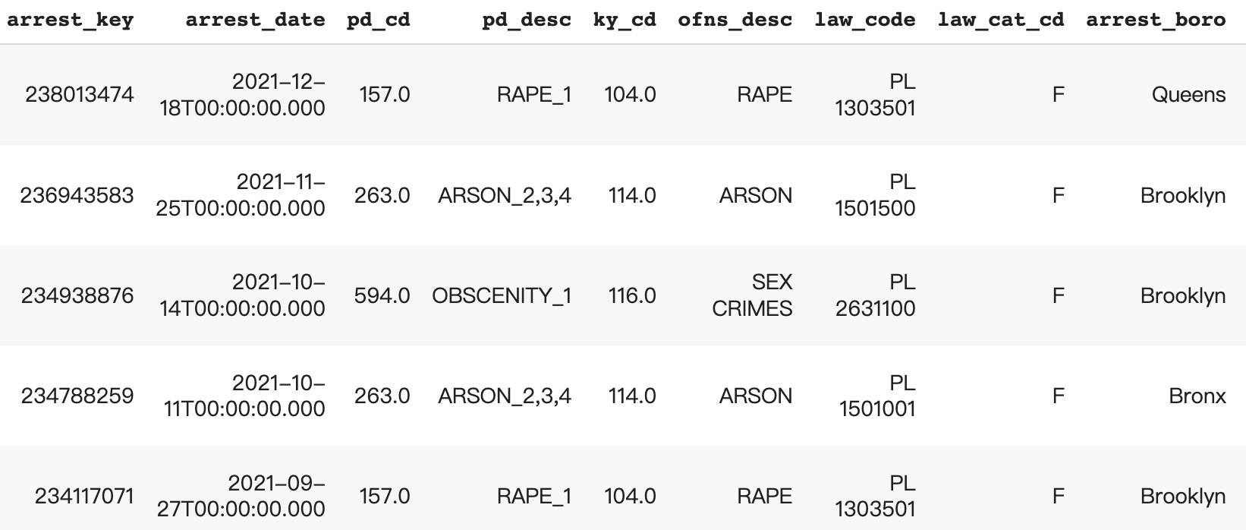
Step 1: Load CSV into Python and Format
Data
Extract key datasets, fix issues with null values, ensure proper data types
Update
Convert some data to the appropriate data type, clean the missing value and replace some shorthand values with their full names

Slide 4
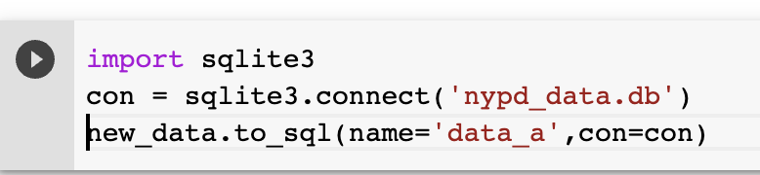
Step 2: Map CSV Data in SQL Tables
Data
Key
Arrest_date
Pd_desc
Arrest_boro
Perp_sex
Age_group
…
Arrest_date
2021-12-18
…
Arrest_boro
Manhattan
…
Age_group
25-44
…
Pd_desc
RAPE
…
Perp_sex
Male
…
……

Slide 5
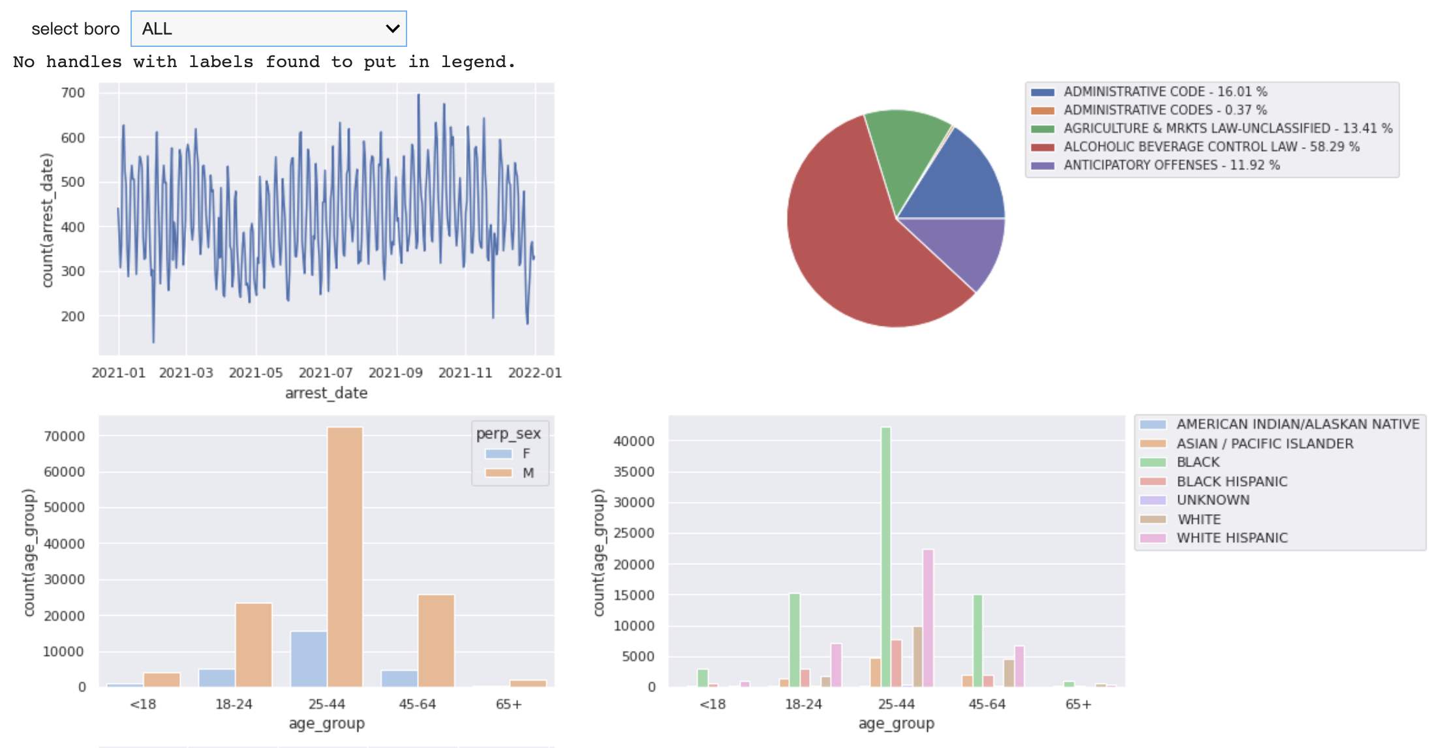
Step3: Propose data questions that can be analyzed
Time series
Offense description
Comparison of the number of crimes in each time period of the year (which time has a higher crime rate and which time period has a lower crime rate)
The proportion of crime types, observe and analyze the proportion of legal violations
Gender-age group
Age group-race
Comparison of the number of crimes by age group and by gender
Comparison of the number of crimes by different races in different age groups

Slide 6
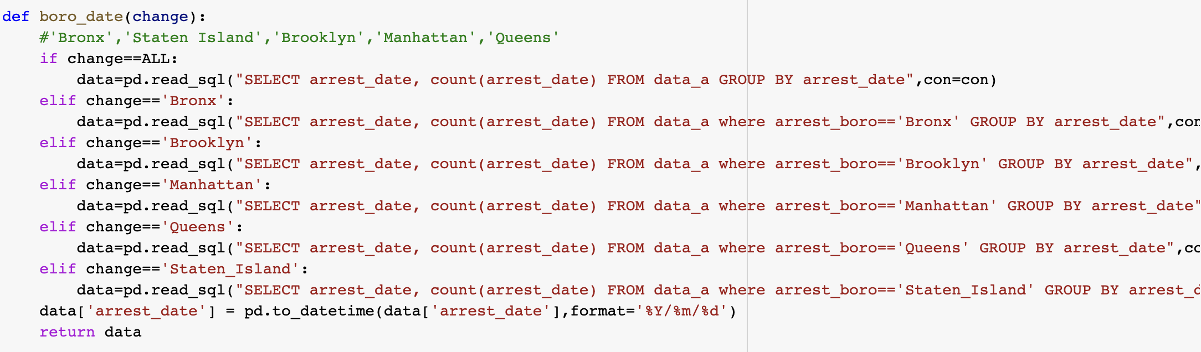
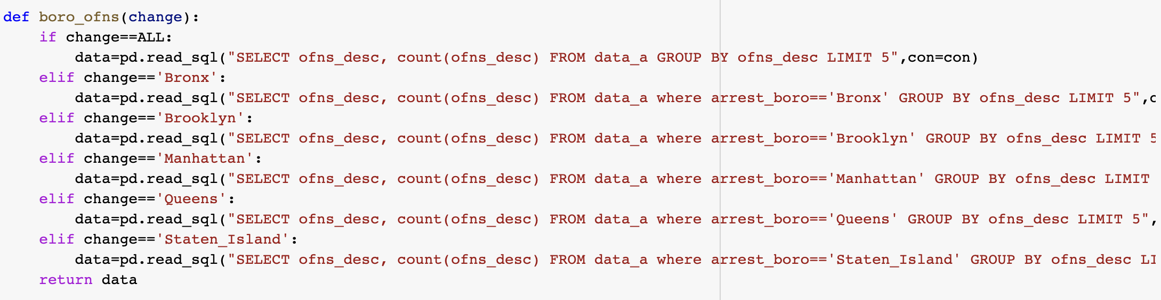
Borough data
Offense description

Slide 7
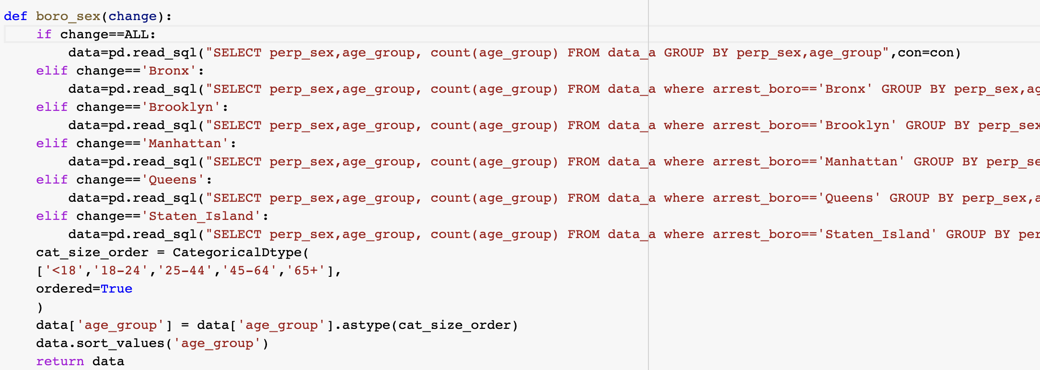
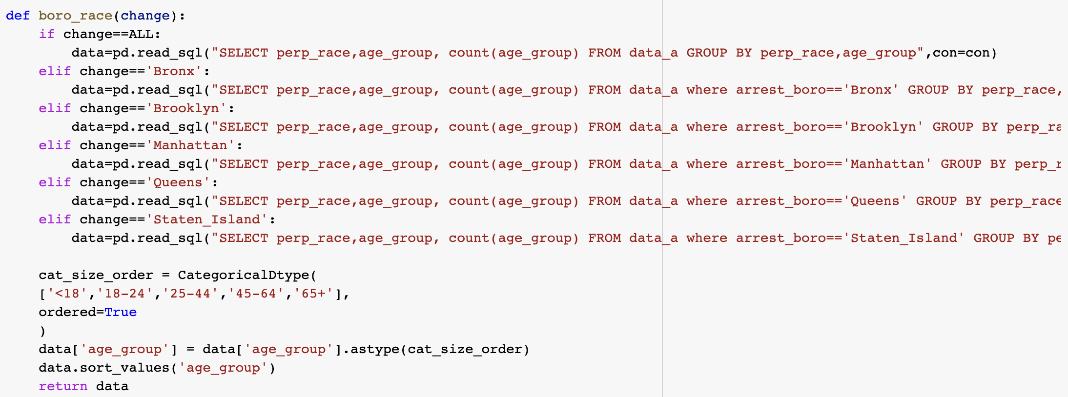
Sex-Age group
Age group-Race

Slide 8
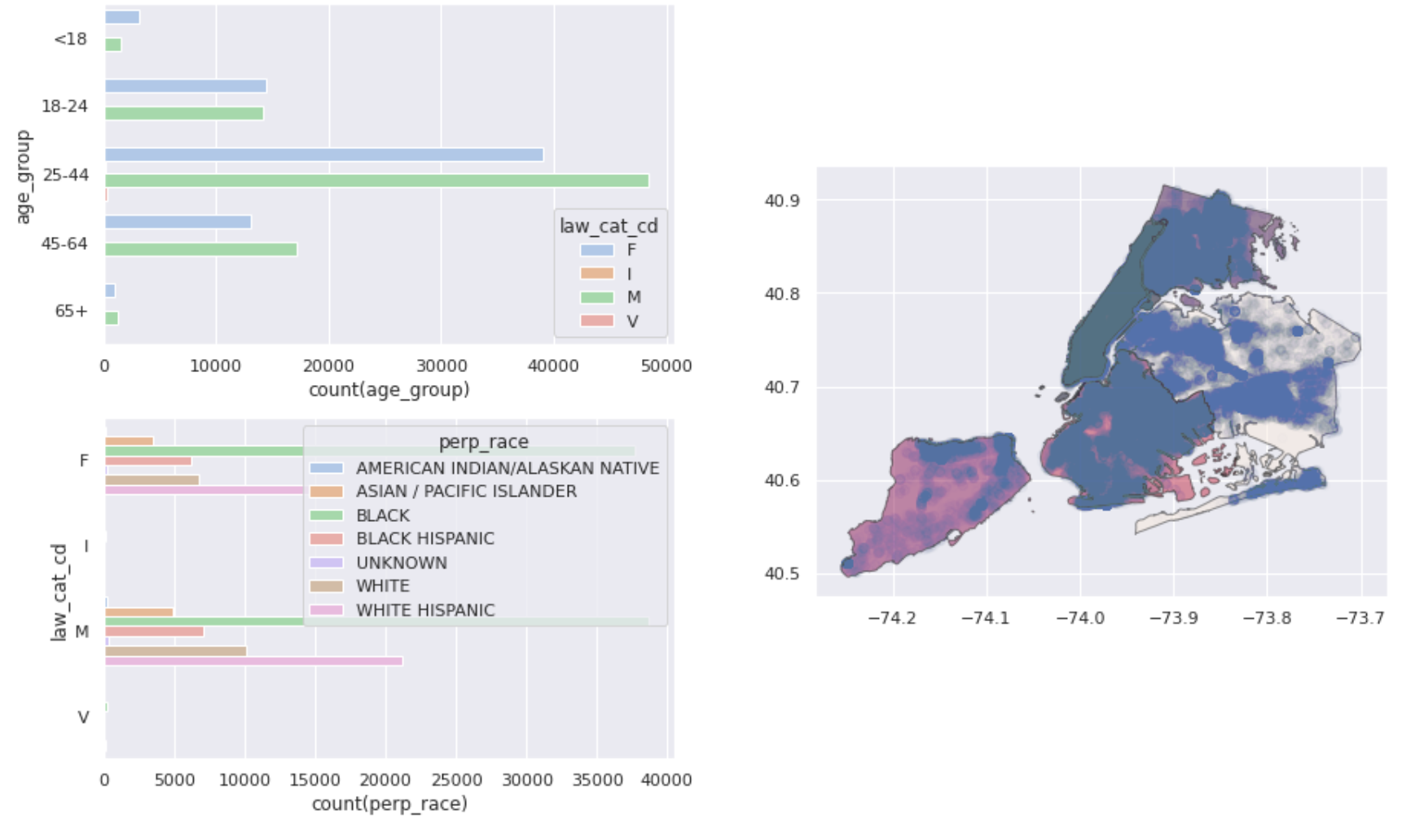
Step3: Propose data questions that can be analyzed
Age-Criminal level
Comparison of crime levels in different age groups. Level of offense: felony, misdemeanor, violation
Borough map
Systematic crime map visualization
Race-Criminal level
Comparison of crime levels of different races

Slide 9
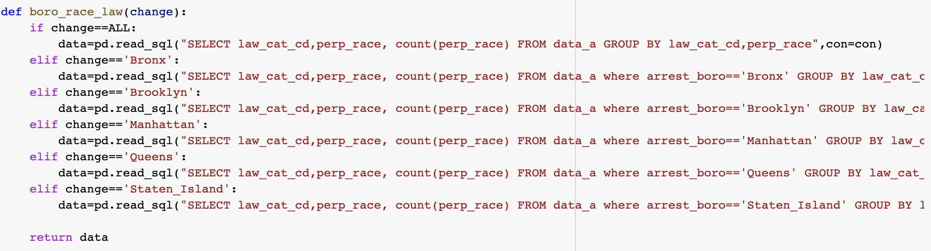

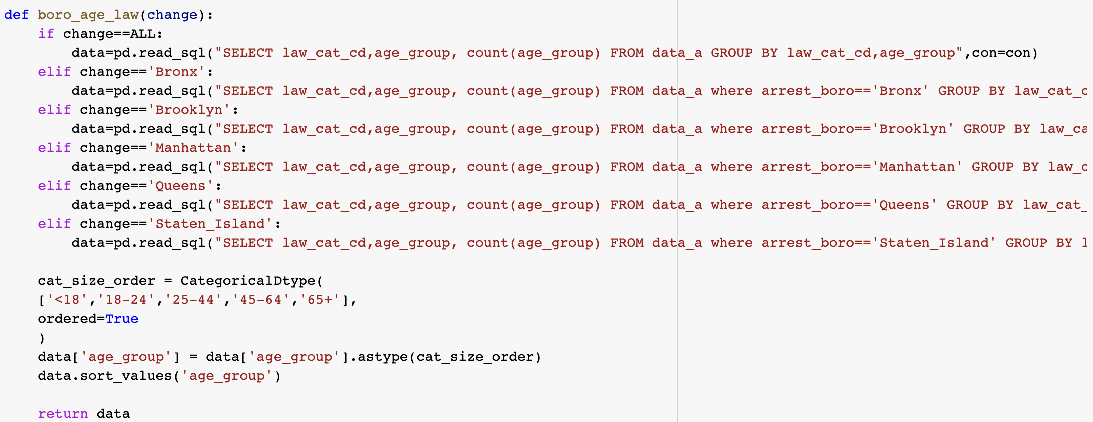
Age group-criminal level
Race-Criminal level

Slide 10
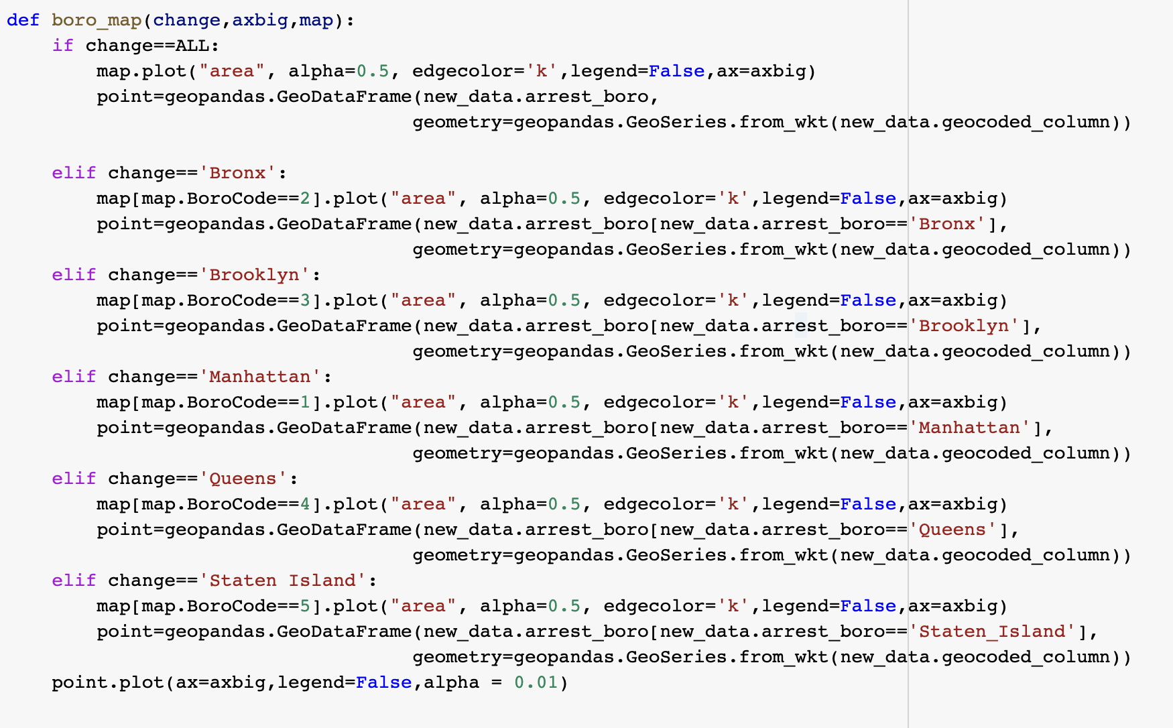
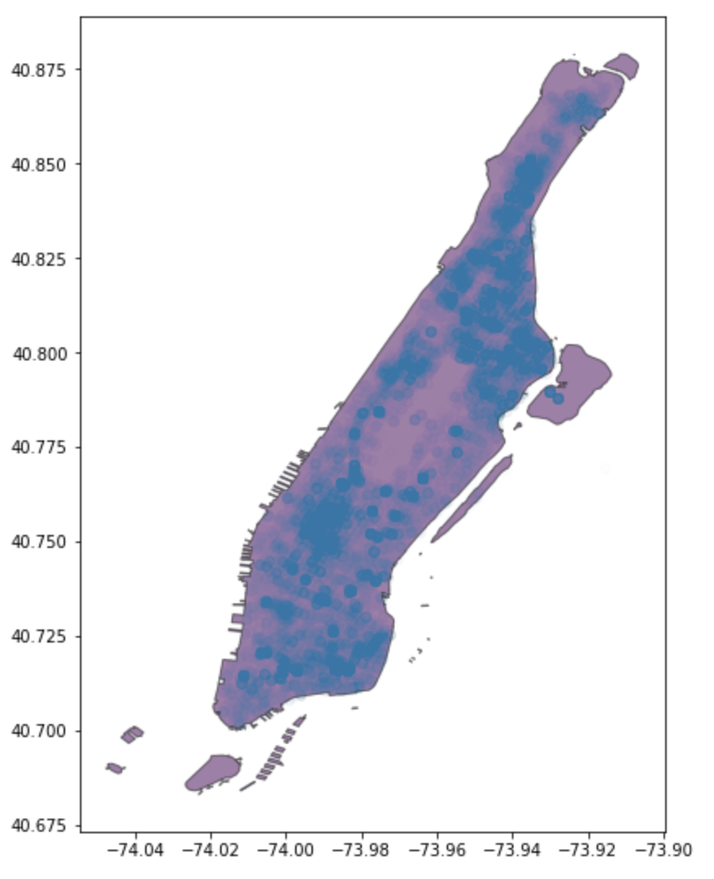
Borough map

Slide 11
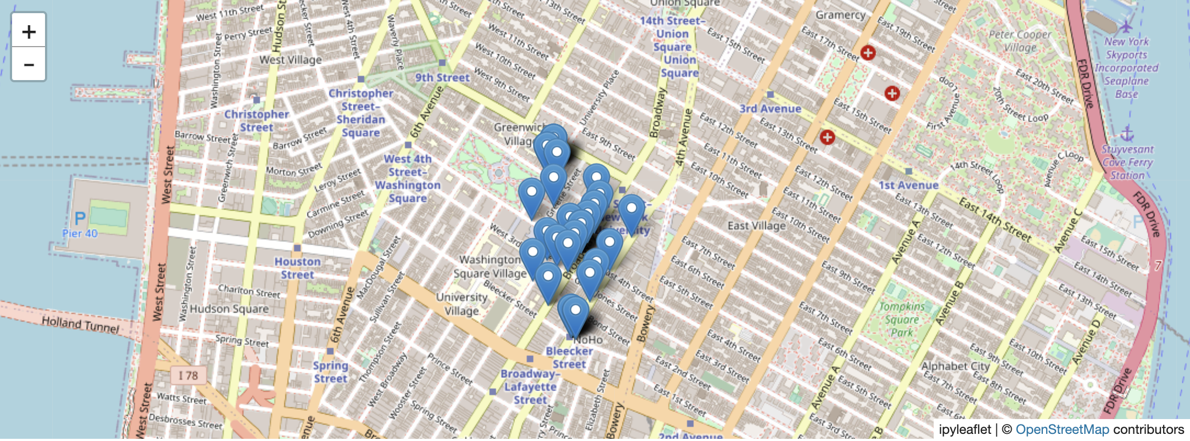
Step4: Arrest Data Map Near Me

Slide 12
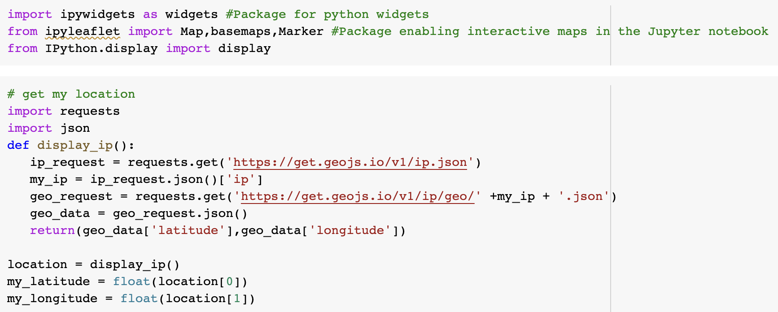
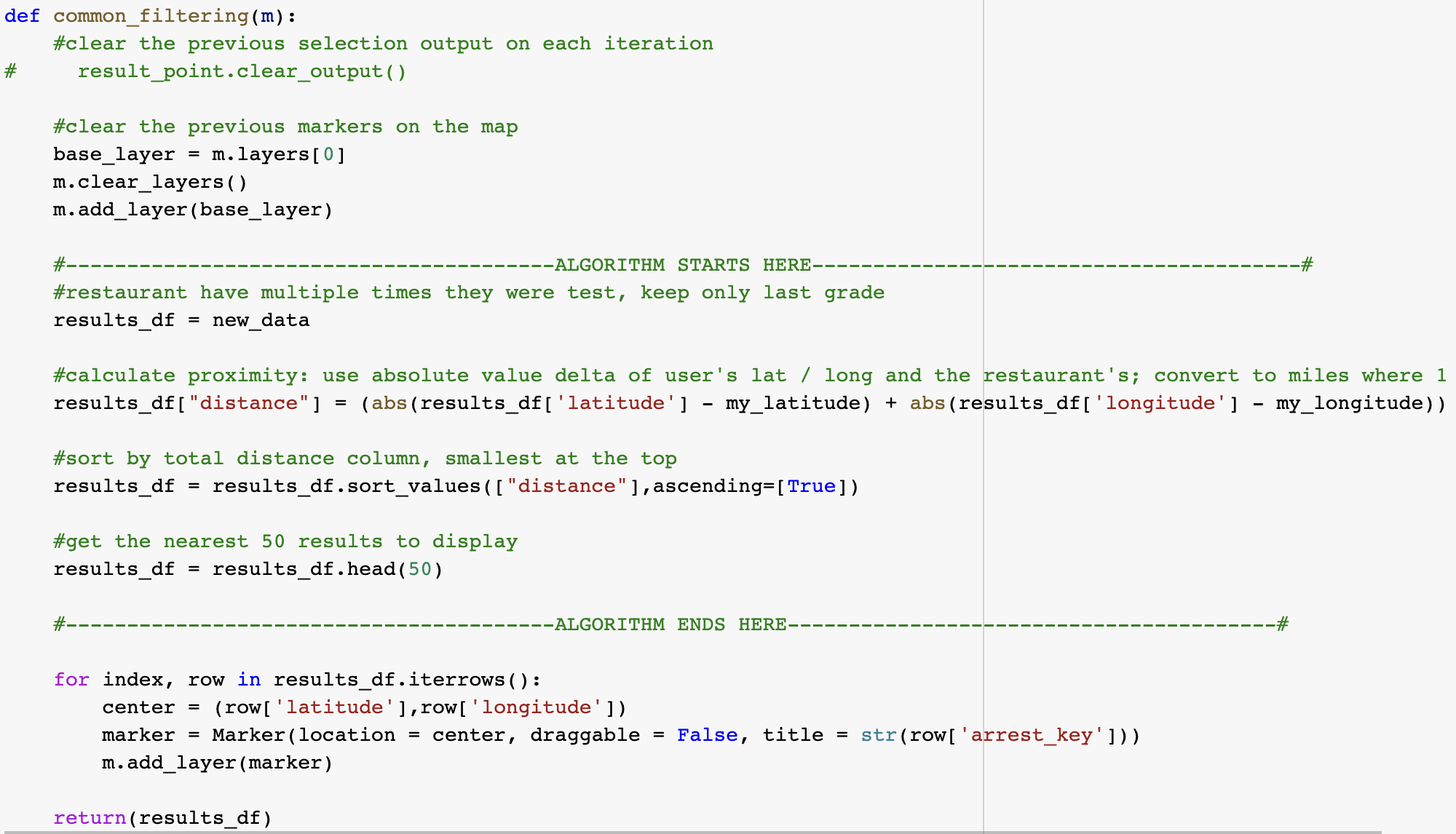
01
Get my location
Get the current IP address
Get the current latitude and longitude by IP address
02
Show the nearest points
Calculate the distance of all data from me by the latitude and longitude
Sort the data by distance
Show the nearest 50 points on the map

Slide 13
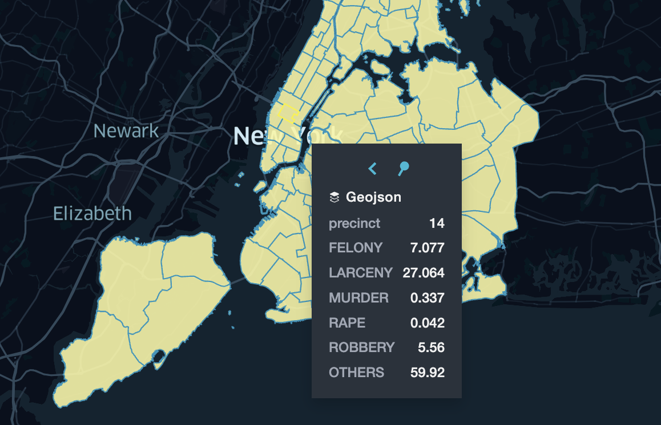
Step5: Exploratory Analysis (Visualization)
Crimes in precincts
Percentage of
crime types
Crimes in each precinct
Five main crime types:
felony
larceny
murder
rape
robbery
others
as the percentage of a total crime.

Slide 14
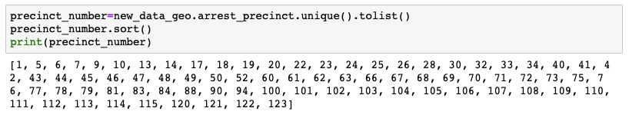
Get precinct number

Slide 15
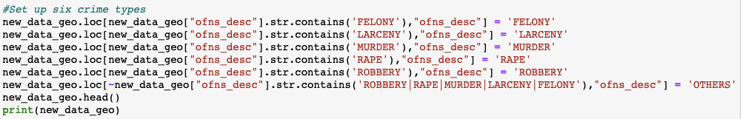
Unify crime types into six types

Slide 16
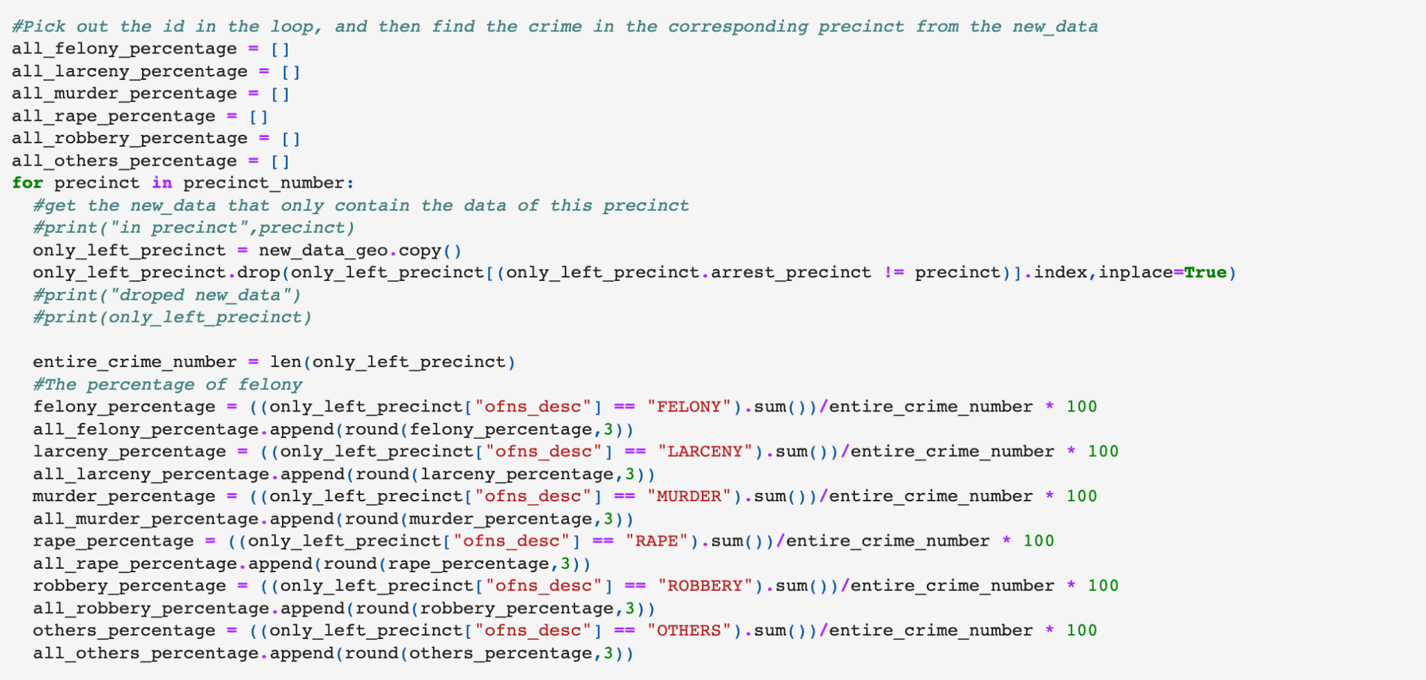
Calculate percentages of crime types in each precinct

Slide 17
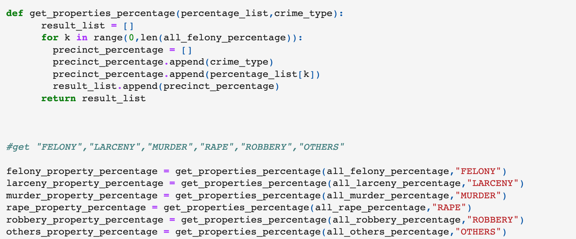
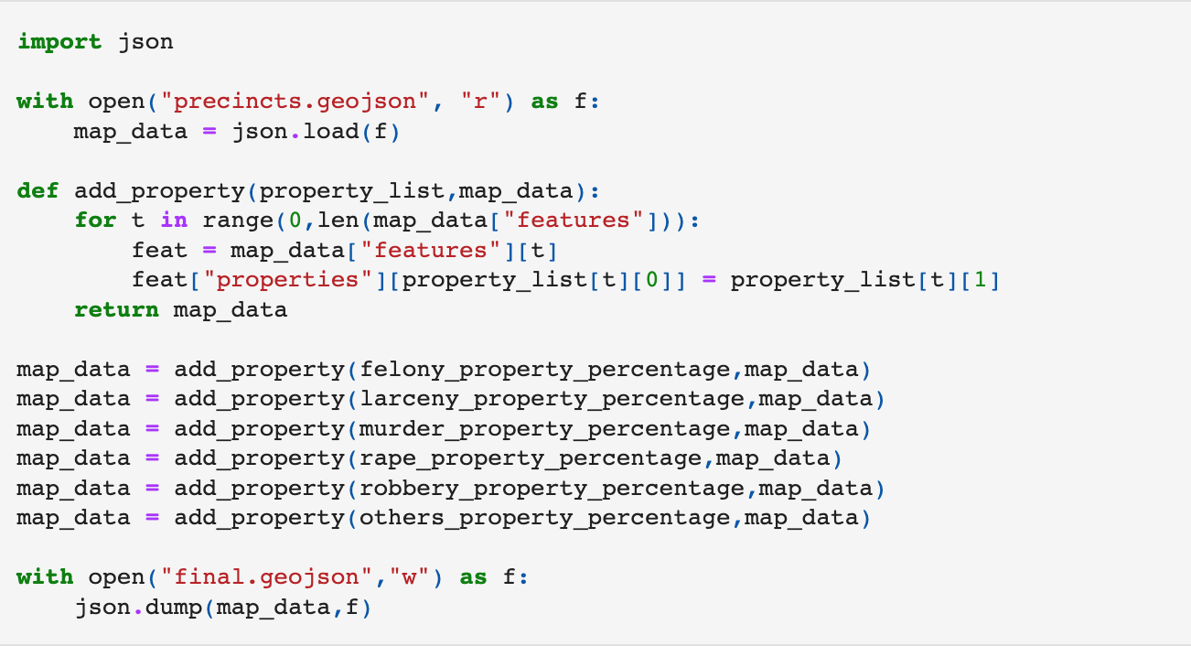
Get
GeoJSON File
Unify data format
Insert data
Get final geojson file

Slide 18
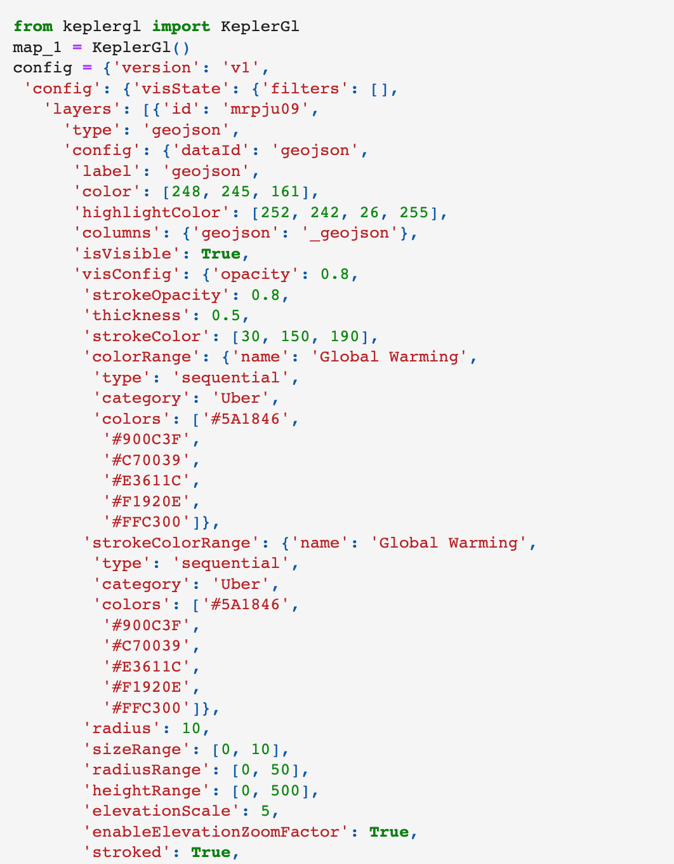
Show NYC Crime Map
Import keplergl
(part of code)

Slide 19
Step 6: Summary
Data cleaning
Crime nearby
Completed seven different data cleaning visualizations
Display nearby crime information by selected coordinates
Swiching Borough button
Statistical Relationship Visualization
Freely switch its independent data map according to the five boroughs of New York
Exploringly analyze and visualize the percentages of different crime types in different precincts

Slide 20
Thank you
Q&A

